Slide 1
BUSINESS INTELLIGENCE & ANALYTICS
p.Rajesh

Slide 2
Contents ….
..\syllabus.docx

Slide 3
Chapter objectives: • Define Business Analytics. • The Relationship Of Analytics And Business Intelligence To The Subject Of Business Analytics. • The Three Steps Of The Business Analytics Process. • Describe Four Data Classification Measurement Scales. • Explain The Relationship Of The Business Analytics Process With The Organization Decision-making Process.
Why is Business Intelligence

Slide 4
BIA TERMS ….
What is it?
Why is it important?
How do you do it?

Slide 5
Terminology
Business analytics begins with a data set (a simple collection of data or a data file) or commonly with a database (a collection of data files that contain information on people, locations, and so on).
As databases grow, they need to be stored somewhere. Technologies such as computer clouds (hardware and software used for data remote storage, retrieval, and computational functions)
Data warehousing (a collection of databases used for reporting and data analysis) store data. Database storage areas have become so large that a new term was devised to describe them.
Big data describes the collection of data sets that are so large and complex that software systems are hardly able to process them

Slide 6
Define little data as anything that is not big data.
Little data describes the smaller data segments or files that help individual businesses keep track of customers. As a means of sorting through data to find useful information, the application of anal
Three terms in business literature are often related to one another: analytics, business analytics, and business intelligence.
Analytics can be defined as a process that involves the use of statistical techniques (measures of central tendency, graphs, and so on), information system software (data mining, sorting routines), and operations research methodologies (linear programming) to explore, visualize, discover, and communicate patterns or trends in data.
Simply, analytics converts data into useful information. Analytics is an older term commonly applied to all disciplines, not just business. A typical example of the use of analytics is the weather measurements collected and converted into statistics, which in turn predict weather patterns.
There are many types of analytics, and there is a need to organize these types to understand their uses. We will adopt the three categories ( descriptive , predictive , and prescriptive )

Slide 7
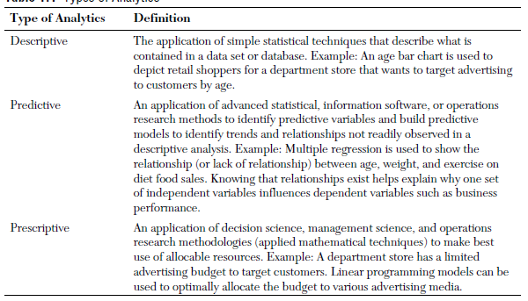

Slide 8
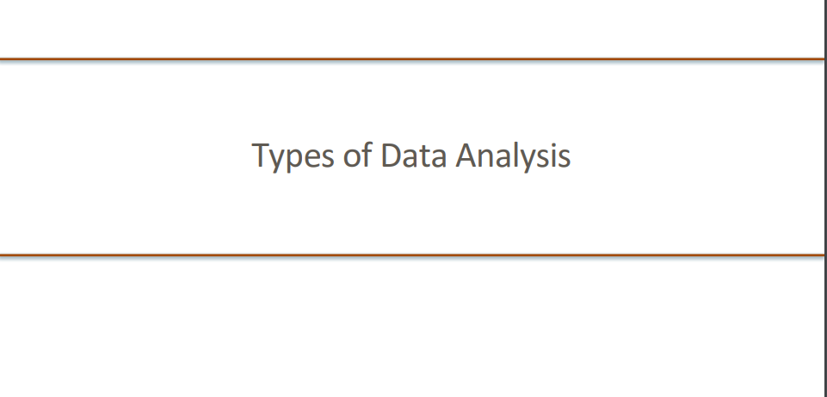

Slide 9
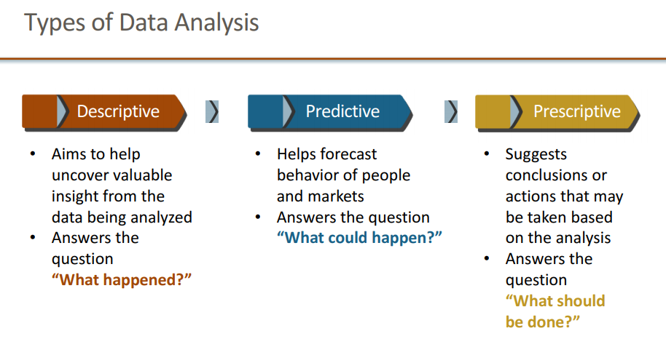

Slide 10
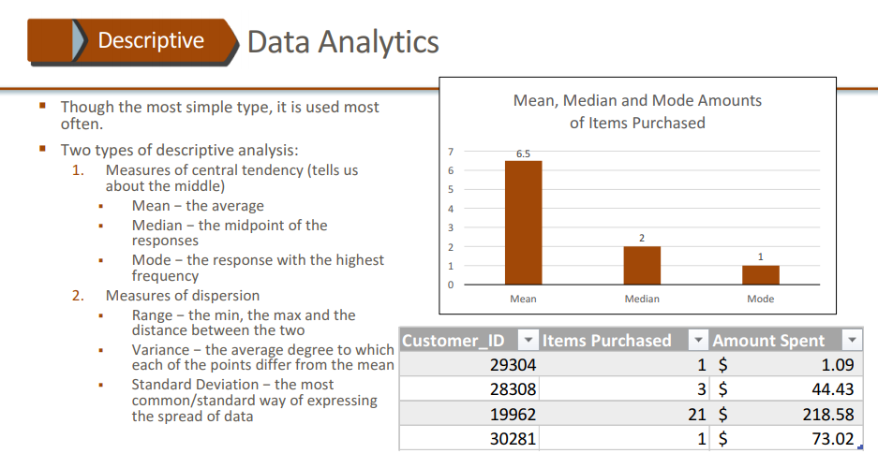

Slide 11
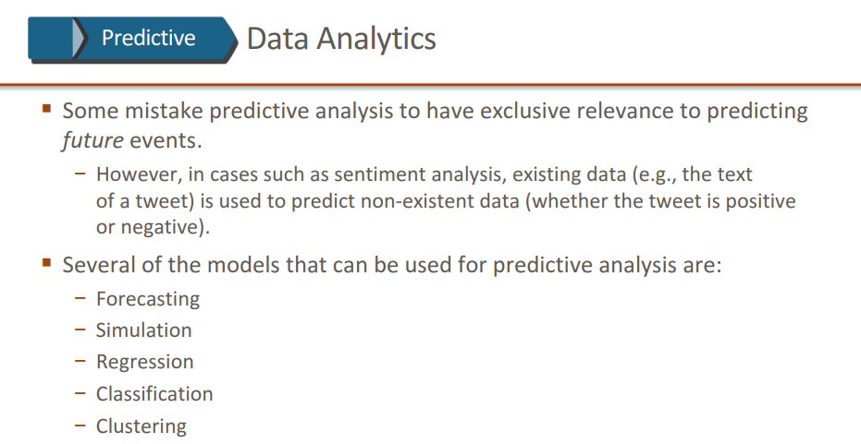

Slide 12
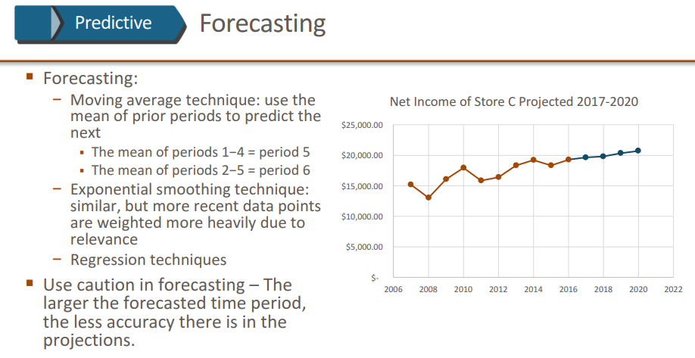

Slide 13
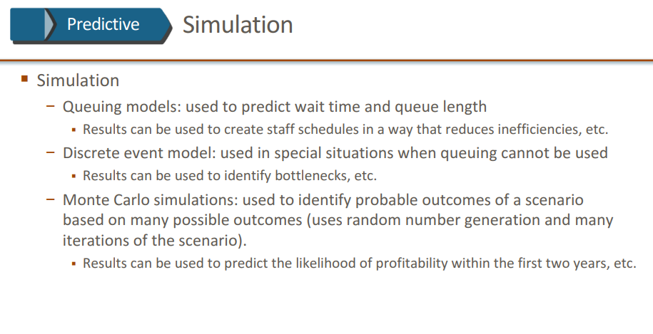

Slide 14
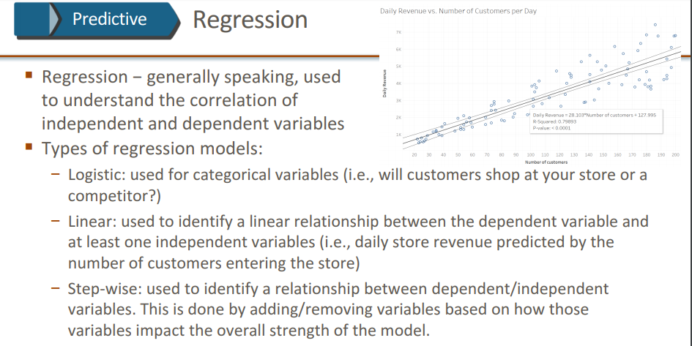

Slide 15
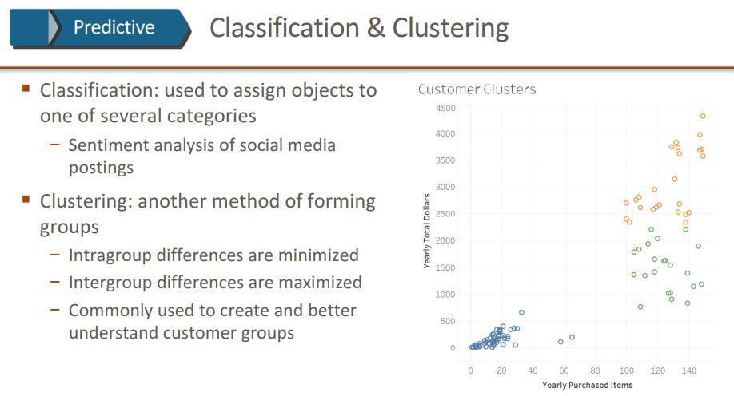

Slide 16
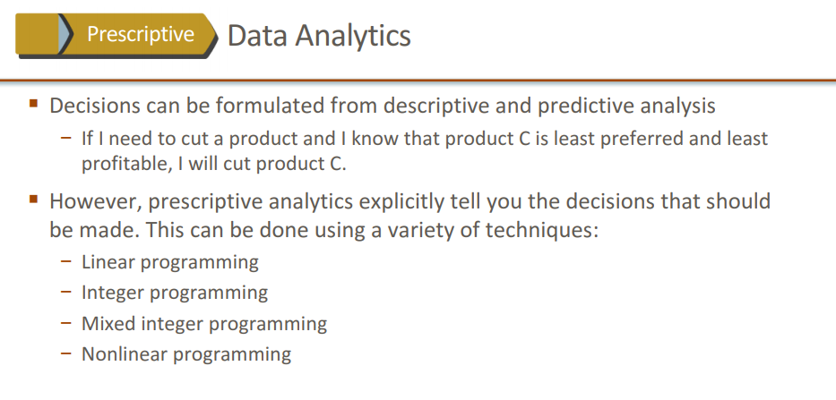

Slide 17
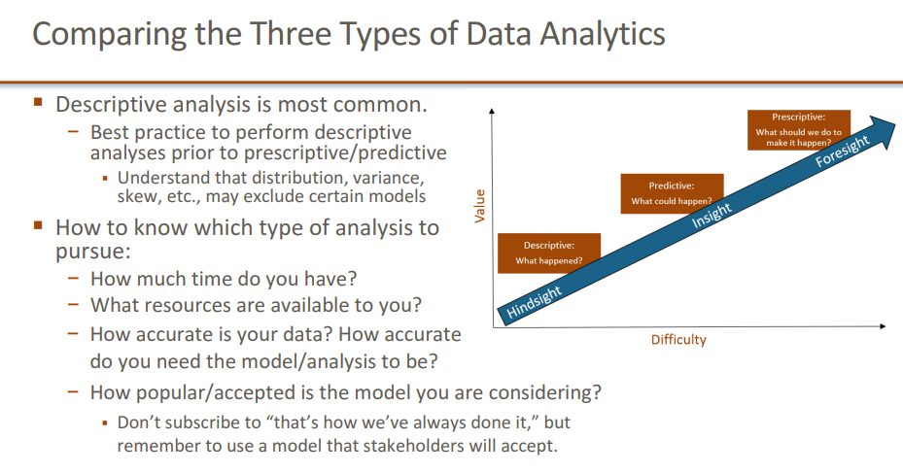

Slide 18
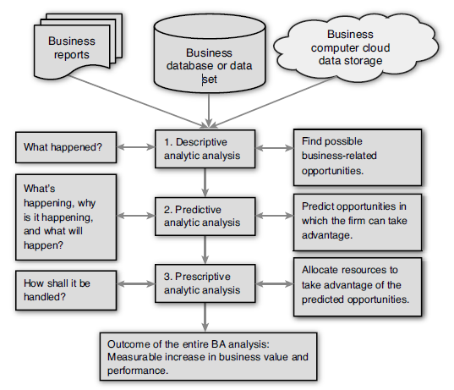
Business Analytics Process

Slide 19
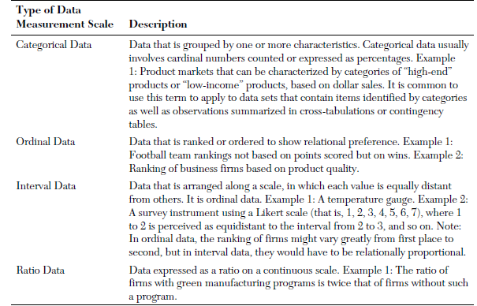
Types of Data Measurement Classification Scales

Slide 20
The Descriptive Analytic analysis some patterns or variables of business behavior should be identified representing targets of business opportunities and possible (but not yet defined) future trend behavior.
Additional effort (more mining) might be required, such as the generation of detailed statistical reports narrowly focused on the data related to targets of business opportunities to explain what is taking place in the data (what happened in the past).

Slide 21
There are many methods that can be used in this step of the BA process.
A commonly used methodology is multiple regression. “Statistical Tools,” and “Forecasting,” for a discussion on multiple regression and ANOVA testing(analysis of variance, a statistical method in which the variation in a set of observations is divided into distinct components).
This methodology is ideal for establishing whether a statistical relationship exists between the predictive variables found in the descriptive analysis.
The relationship might be to show that a dependent variable is predictively associated with business value or performance of some kind.
Exploring a database using advanced statistical procedures to verify and confirm the best predictive variables is an important part of this step in the BA process.

Slide 22
Relationship of BA Process and Organization Decision-Making Process
The BA process can solve problems and identify opportunities to improve business performance.
In the process, organizations may also determine strategies to guide operations and help achieve competitive advantages.
Typically, solving problems and identifying strategic opportunities to follow are organization decision-making tasks.
The latter, identifying opportunities, can be viewed as a problem of strategy choice requiring a solution.

Slide 23
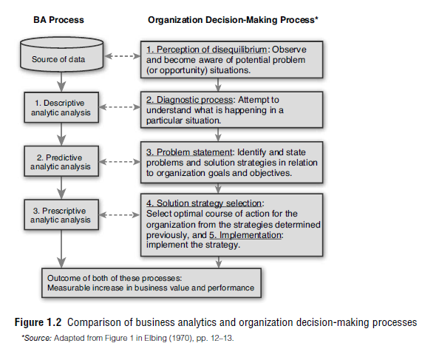

Slide 24
The organization decision-making process (ODMP) is focused on decision-making to solve problems but could also be applied to finding opportunities in data and deciding what is the best course of action to take advantage of them.
The five-step ODMP begins with the perception of disequilibrium, or the awareness that a problem exists that needs a decision.
Similarly, in the BA process, the first step is to recognize that databases may contain information that could both solve problems and find opportunities to improve business performance.
Then in Step 2 of the ODMP, an exploration of the problem to determine its size, impact, and other factors is undertaken to diagnose what the problem is. Likewise, the BA descriptive analytic analysis explores factors that might prove useful in solving problems and offering opportunities.
The ODMP problem statement step is similarly structured to the BA predictive analysis to find strategies, paths, or trends that clearly define a problem or opportunity for an organization to solve problems.
Finally, the ODMP’s last steps of strategy selection and implementation involve the same kinds of tasks that the BA process requires in the final prescriptive step(make an optimal selection of resource allocations that can be implemented for the betterment of the organization).
The decision-making foundation that has served ODMP for many decades parallels the BA process.
The same logic serves both processes and supports organization decision-making skills and capacities.

Slide 25
DATA COLLECTION,PROCESSING AND
ANALYSIS
STEPS IN DATA COLLECTION
The first two steps relate to the collection of primary data while the third step relates to the collection of secondary data.
The information/data collected by a person directly is known as primary data while records or data collected from offices/institutions is known as secondary data.

Slide 26
A. Steps in Primary Data Collection:
1. Making oneself ready both mentally as well as physically for collecting primary data from field situations.
2. Keeping a field book/record book or diary for writing relevant information, doing field sketching or writing records of the occurrence of phenomenon at specific time intervals.
3. Administering questionnaire schedule to the target groups of area people across sampled sites.
4. Verifying the facts through cross checks in the answers and ground realties.
5. Integrating the observations, responses and recorded facts in a systematic and logical framework.
B. Steps in Secondary Data Collection:
1. Knowledge about the offices/institutes etc. keeping the record of relevant data is of prime importance to obtain the secondary data/information.
2. Get an official letter containing your requirements of data and purpose of data collection from your Principal/Head of the Institute? Your identity card is also an essential requirement to get an entry in the offices.
3. Keep a note book/record file to transfer data for the purpose. It could also be done with the help of photo copying systems.
4. The secondary data, thus, collected forms the basis for tabulation and processing as per need.

Slide 27
TOOLS AND TECHNIQUES OF DATA COLLECTION
For data collection we make use of certain tools and follow specific techniques. The tools that help in data collection are as under:
􀁺 Observing the phenomenon and recording the details,
􀁺 Inquiring about the facts through questionnaires/schedules
􀁺 Making measurements.
􀁺 Conducting tests.
􀁺 Recording the events.

Slide 28
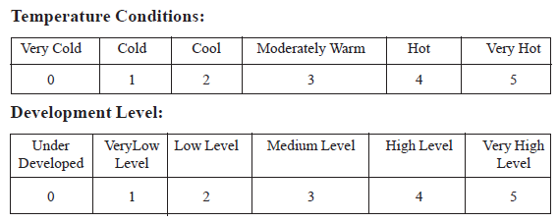
A. Questionnaires:
(a) Contents of Questionnaire:
(b) Form of Questionnaire:
(c) The Interview
B. The Schedules
C. Rating Scales
D. Field Sketches
E. Photographs

Slide 29
F. Methods of Administering the Questionnaires and Survey Schedules
G. Collection of Information
H. Precautions in Collecting the Information
I. Selection of Samples and Sample Size
1) Identification of Samples:
2) Sampling Techniques
Systematic Sampling
Random Sampling
Simple Random Sampling:
Stratified Random Sampling
3) Sample Size:

Slide 30
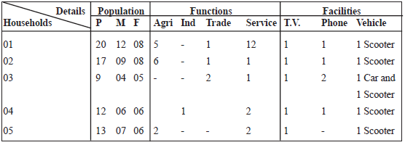
PROCESSING OF DATA
Processing of primary data:
Editing of data:
The coding of data:
Organization of Data:
Classification of data:

Slide 31
Presentation of data:
Tabular Presentation
Statistical Presentation of data:
(a) Arithmetic mean or average
(b) Median
(c) Mode

Slide 32
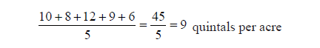
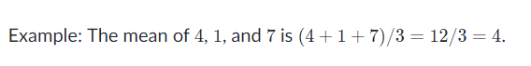
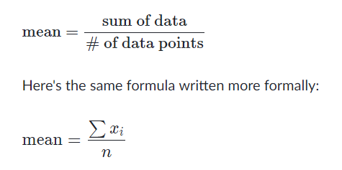
Arithmetic Mean
Mean: The "average" number; found by adding all data points and dividing by the number of data points.
For example, the production of rice per acre in five districts is 10, 8, 12,9 and 6 quintals. The average production of rice for these districts is :
The arithmetic mean is the sum of all of the data points divided by the number of data points.

Slide 33
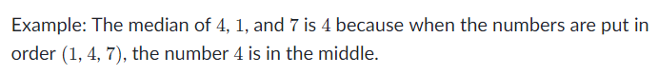
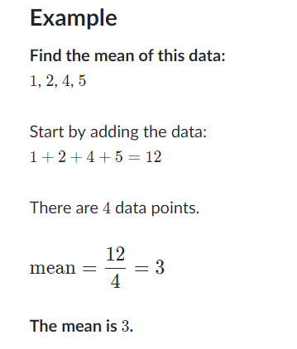
Median: The middle number; found by ordering all data points and picking out the one in the middle (or if there are two middle numbers, taking the mean of those two numbers).

Slide 34
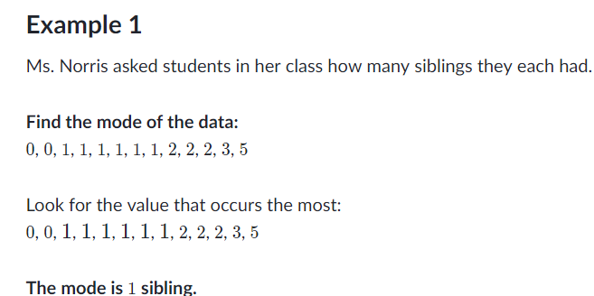
Mode: The most frequent number—that is, the number that occurs the highest number of times.

Slide 35
Data Exploration
1. Steps of Data Exploration and Preparation
Remember the quality of your inputs decide the quality of your output.
Example:
So, once you have got your business hypothesis ready, it makes sense to spend lot of time and efforts here. With estimate, data exploration, cleaning and preparation can take up to 70% of your total project time.
Below are the steps involved to understand, clean and prepare your data for building your predictive model:
1. Variable Identification
2. Univariate Analysis
3. Bi-variate Analysis
4. Missing values treatment
5. Outlier treatment

Slide 36
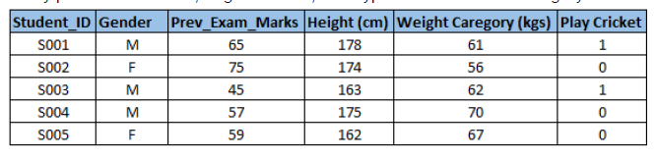
1.Variable Identification
First, identify Predictor (Input) and Target (output) variables.
Next, identify the data type and category of the variables.
Example:- Suppose, we want to predict, whether the students will play cricket or not (refer below data set). Here you need to identify predictor variables, target variable, data type of variables and category of variables.

Slide 37
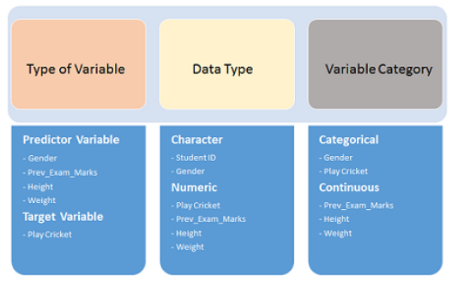

Slide 38
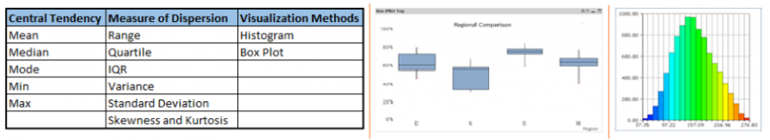
2.Univariate Analysis
At this stage, we explore variables one by one.
Method to perform uni-variate analysis will depend on whether the variable type is categorical or continuous.
Let’s look at these methods and statistical measures for categorical and continuous variables individually:
Continuous Variables:-
In case of continuous variables, we need to understand the central tendency and spread of the variable.
These are measured using various statistical metrics visualization methods as shown below:

Slide 39
Categorical Variables:-
For categorical variables, we’ll use frequency table to understand distribution of each category.
We can also read as percentage of values under each category.
It can be be measured using two metrics, Count and Count% against each category.
Bar chart can be used as visualization.

Slide 40
3.Bi-variate Analysis
Bi-variate Analysis finds out the relationship between two variables.
Here, we look for association and disassociation between variables at a pre-defined significance level.
We can perform bi-variate analysis for any combination of categorical and continuous variables.
The combination can be: Categorical & Categorical, Categorical & Continuous and Continuous & Continuous.
Different methods are used to tackle these combinations during analysis process.
Continuous & Continuous:
While doing bi-variate analysis between two continuous variables, we should look at scatter plot.
It is a nifty way to find out the relationship between two variables.
The pattern of scatter plot indicates the relationship between variables.
The relationship can be linear or non-linear.

Slide 41
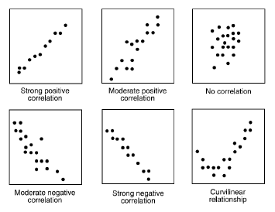

Slide 42
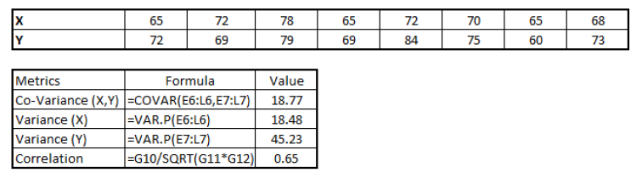
Scatter plot shows the relationship between two variable but does not indicates the strength of relationship amongst them.
To find the strength of the relationship, we use Correlation.
Correlation varies between -1 and +1.
-1: perfect negative linear correlation
+1:perfect positive linear correlation and
0: No correlation
Correlation can be derived using following formula:
Correlation = Covariance(X,Y) / SQRT( Var(X)* Var(Y))

Slide 43
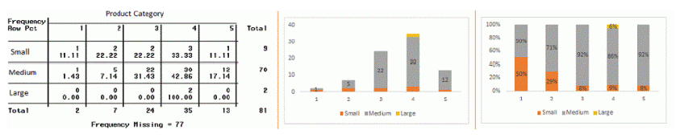
Categorical & Categorical: To find the relationship between two categorical variables, we can use following methods:
Two-way table: We can start analyzing the relationship by creating a two-way table of count and count%.
The rows represents the category of one variable and the columns represent the categories of the other variable.
We show count or count% of observations available in each combination of row and column categories.
Stacked Column Chart: This method is more of a visual form of Two-way table.

Slide 44
Chi-Square Test: This test is used to derive the statistical significance of relationship between the variables. Also, it tests whether the evidence in the sample is strong enough to generalize that the relationship for a larger population as well.
Chi-square is based on the difference between the expected and observed frequencies in one or more categories in the two-way table.
It returns probability for the computed chi-square distribution with the degree of freedom.
Probability of 0: It indicates that both categorical variable are dependent
Probability of 1: It shows that both variables are independent.
Probability less than 0.05: It indicates that the relationship between the variables is significant at 95% confidence.
The chi-square test statistic for a test of independence of two categorical variables is found by

Slide 45
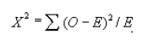
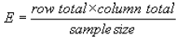
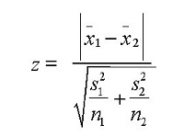
where O represents the observed frequency.
E is the expected frequency under the null hypothesis and computed by:
Categorical & Continuous: While exploring relation between categorical and continuous variables, we can draw box plots for each level of categorical variables.
If levels are small in number, it will not show the statistical significance.
To look at the statistical significance we can perform Z-test, T-test or ANOVA.
Z-Test/ T-Test:- Either test assess whether mean of two groups are statistically different from each other or not.

Slide 46
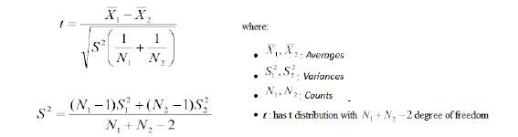
If the probability of Z is small then the difference of two averages is more significant.
The T-test is very similar to Z-test but it is used when number of observation for both categories is less than 30.

Slide 47
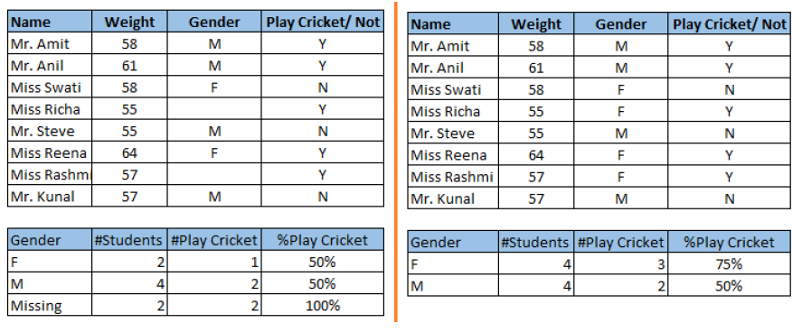
Missing Value Treatment
Missing data in the training data set can reduce the power / fit of a model or can lead to a biased model because we have not analyzed the behavior and relationship with other variables correctly. It can lead to wrong prediction or classification.

Slide 48
In the left scenario, we have not treated missing values.
The inference from this data set is that the chances of playing cricket by males is higher than females. On the other hand, if you look at the second table, which shows data after treatment of missing values (based on gender), we can see that females have higher chances of playing cricket compared to males.
We looked at the importance of treatment of missing values in a dataset. Now, let’s identify the reasons for occurrence of these missing values. They may occur at two stages:
1. Data Extraction: It is possible that there are problems with extraction process. In such cases, we should double-check for correct data with data guardians. Some hashing procedures can also be used to make sure data extraction is correct. Errors at data extraction stage are typically easy to find and can be corrected easily as well.

Slide 49
2. Data collection: These errors occur at time of data collection and are harder to correct. They can be categorized in four types:
Missing completely at random: This is a case when the probability of missing variable is same for all observations.
For example: respondents of data collection process decide that they will declare their earning after tossing a fair coin. If an head occurs, respondent declares his / her earnings & vice versa.
Here each observation has equal chance of missing value.
Missing at random: This is a case when variable is missing at random and missing ratio varies for different values / level of other input variables. For example: We are collecting data for age and female has higher missing value compare to male.
Missing that depends on unobserved predictors: This is a case when the missing values are not random and are related to the unobserved input variable. For example: In a medical study, if a particular diagnostic causes discomfort, then there is higher chance of drop out from the study. This missing value is not at random unless we have included “discomfort” as an input variable for all patients.
Missing that depends on the missing value itself: This is a case when the probability of missing value is directly correlated with missing value itself. For example: People with higher or lower income are likely to provide non-response to their earning.

Slide 50
Which are the methods to treat missing values ?
1. Deletion: It is of two types:
List Wise Deletion & Pair Wise Deletion.
In list wise deletion, we delete observations where any of the variable is missing. Simplicity is one of the major advantage of this method, but this method reduces the power of model because it reduces the sample size.
In pair wise deletion, we perform analysis with all cases in which the variables of interest are present. Advantage of this method is, it keeps as many cases available for analysis. One of the disadvantage of this method, it uses different sample size for different variables

Slide 51
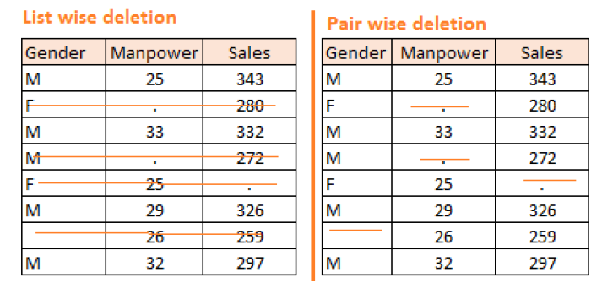
Deletion methods are used when the nature of missing data is “Missing completely at random” else non random missing values can bias the model output.

Slide 52
2. Mean/ Mode/ Median Imputation: Imputation is a method to fill in the missing values with estimated ones.
The objective is to employ known relationships that can be identified in the valid values of the data set to assist in estimating the missing values.
It consists of replacing the missing data for a given attribute by the mean or median (quantitative attribute) or mode (qualitative attribute) of all known values of that variable.
It can be of two types:-
Generalized Imputation: In this case, we calculate the mean or median for all non missing values of that variable then replace missing value with mean or median.
“Manpower” is missing so we take average of all non missing values of “Manpower” (28.33) and then replace missing value with it.
case Imputation: In this case, we calculate average for gender “Male” (29.75) and “Female” (25) individually of non missing values then replace the missing value based on gender. For “Male“, we will replace missing values of manpower with 29.75 and for “Female” with 25.
3. Prediction Model: Prediction model is one of the sophisticated method for handling missing data. Here, we create a predictive model to estimate values that will substitute the missing data.

Slide 53
4. KNN Imputation: In this method of imputation, the missing values of an attribute are imputed using the given number of attributes that are most similar to the attribute whose values are missing.
The similarity of two attributes is determined using a distance function. It is also known to have certain advantage & disadvantages.
Advantages:
k-nearest neighbour can predict both qualitative & quantitative attributes
Creation of predictive model for each attribute with missing data is not required
Attributes with multiple missing values can be easily treated
Correlation structure of the data is taken into consideration
Disadvantage:
KNN algorithm is very time-consuming in analyzing large database. It searches through all the dataset looking for the most similar instances.
Choice of k-value is very critical. Higher value of k would include attributes which are significantly different from what we need whereas lower value of k implies missing out of significant attributes.

Slide 54
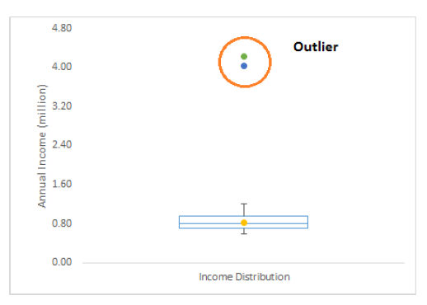
Techniques of Outlier Detection and Treatment
What is an Outlier?
Outlier is a commonly used terminology by analysts and data scientists as it needs close attention else it can result in wildly wrong estimations.
Simply speaking, Outlier is an observation that appears far away and diverges from an overall pattern in a sample.
Let’s take an example, we do customer profiling and find out that the average annual income of customers is $0.8 million. But, there are two customers having annual income of $4 and $4.2 million.
These two customers annual income is much higher than rest of the population. These two observations will be seen as Outliers

Slide 55
classified in two broad categories:
1. Artificial (Error) / Non-natural
2. Natural.
Let’s understand various types of outliers in more detail:
Data Entry Errors:- Human errors such as errors caused during data collection, recording, or entry can cause outliers in data.
For example: Annual income of a customer is $100,000. Accidentally, the data entry operator puts an additional zero in the figure. Now the income becomes $1,000,000 which is 10 times higher.
Measurement Error: It is the most common source of outliers. This is caused when the measurement instrument used turns out to be faulty.
For example: There are 10 weighing machines. 9 of them are correct, 1 is faulty. Weight measured by people on the faulty machine will be higher / lower than the rest of people in the group.

Slide 56
Experimental Error: Another cause of outliers is experimental error.
For example: In a 100m sprint of 7 runners, one runner missed out on concentrating on the ‘Go’ call which caused him to start late. Hence, this caused the runner’s run time to be more than other runners. His total run time can be an outlier.
Intentional Outlier: This is commonly found in self-reported measures that involves sensitive data.
For example: Teens would typically under report the amount of alcohol that they consume. Only a fraction of them would report actual value. Here actual values might look like outliers because rest of the teens are under reporting the consumption.
Data Processing Error: Whenever we perform data mining, we extract data from multiple sources. It is possible that some manipulation or extraction errors may lead to outliers in the dataset.
Sampling error: For instance, we have to measure the height of athletes. By mistake, we include a few basketball players in the sample. This inclusion is likely to cause outliers in the dataset.
Natural Outlier: When an outlier is not artificial (due to error), it is a natural outlier.
For instance: In my last assignment with one of the renowned insurance company, I noticed that the performance of top 50 financial advisors was far higher than rest of the population. Surprisingly, it was not due to any error.

Slide 57
DATA CLEANSING

Slide 58
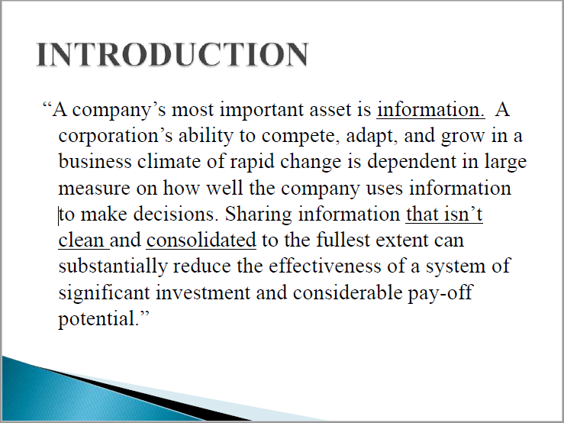

Slide 59
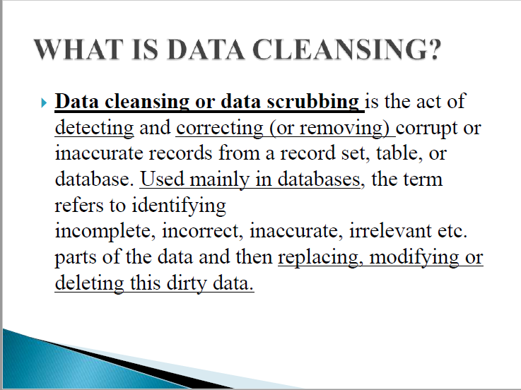

Slide 60
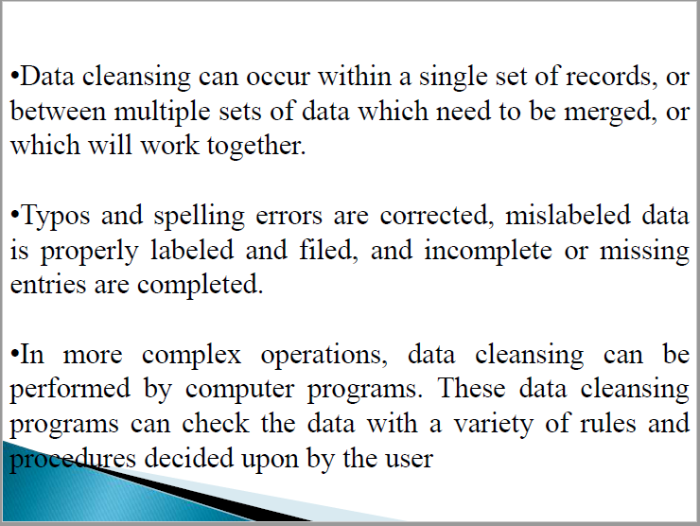

Slide 61
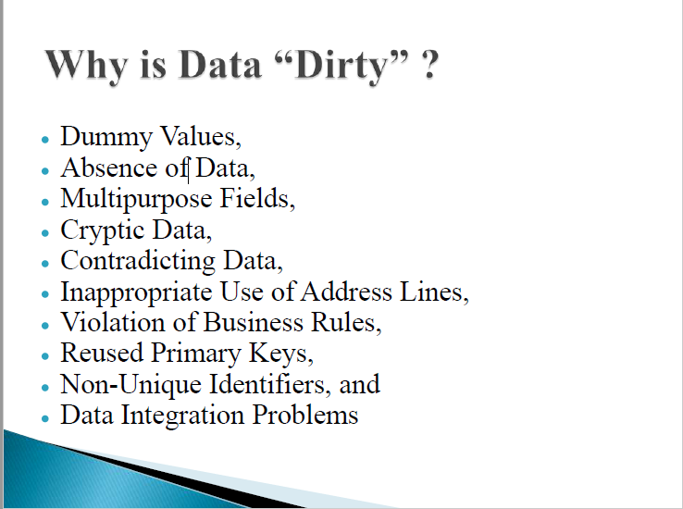
•The goal of data cleansing is not just to clean up the data in a database but also to bring consistency to different sets of data that have been merged from separate databases.

Slide 62
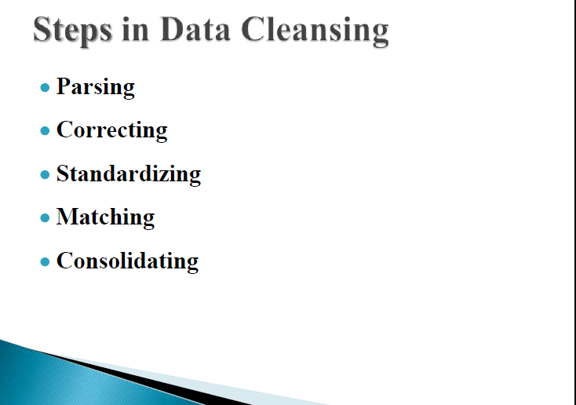

Slide 63
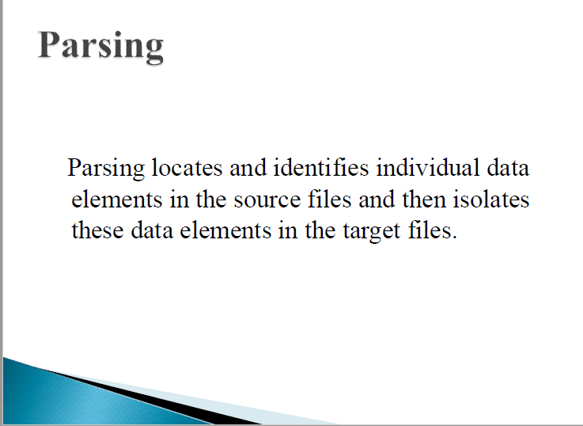

Slide 64
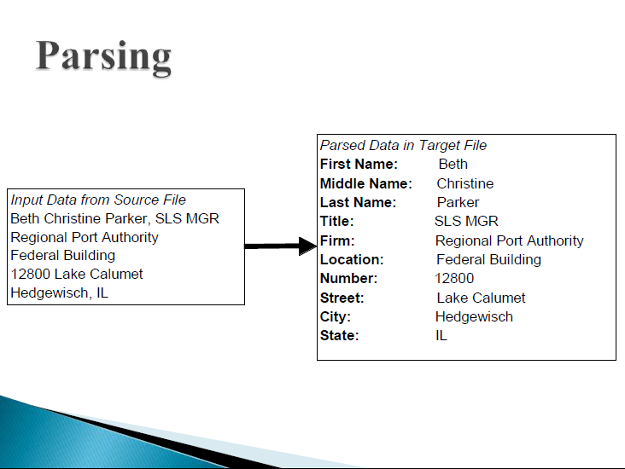

Slide 65
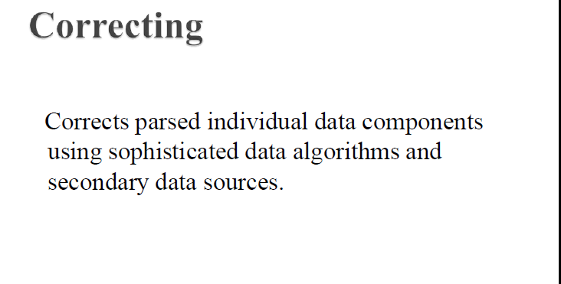

Slide 66
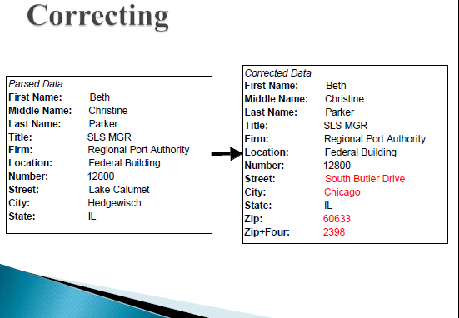

Slide 67
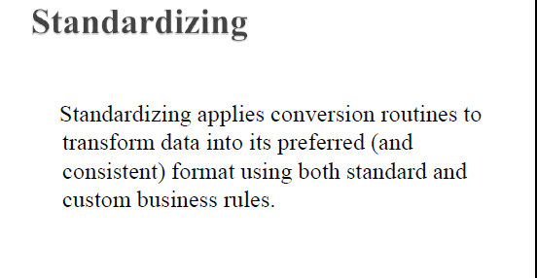

Slide 68
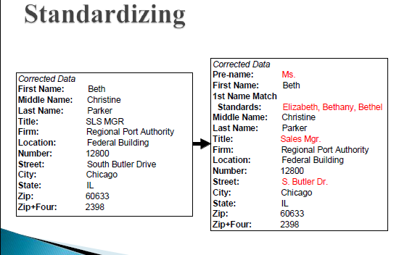

Slide 69
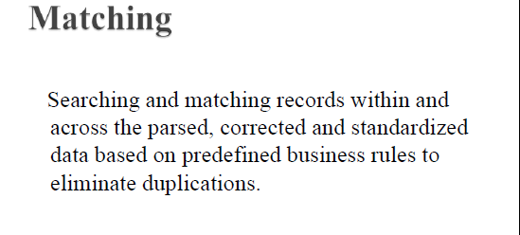

Slide 70
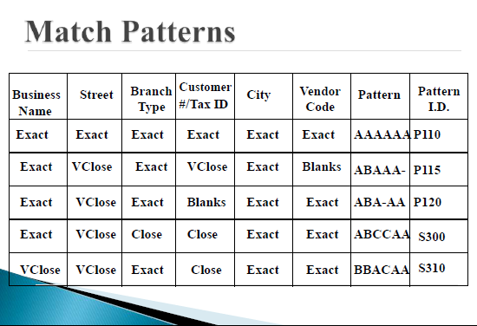

Slide 71
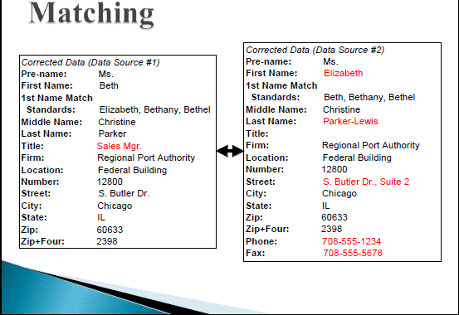

Slide 72
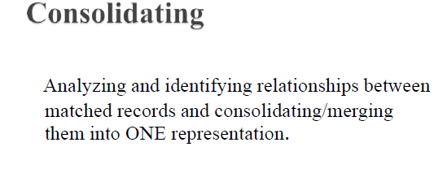

Slide 73


Slide 74


Slide 75


Slide 76


Slide 77


Slide 78


Slide 79


Slide 80


Slide 81


Slide 82


Slide 83


Slide 84


Slide 85


Slide 86


Slide 87


Slide 88


Slide 89


Slide 90


Slide 91


Slide 92


Slide 93


Slide 94


Slide 95
..\..\unit 1\statistical methods\Statistics - Adjusted R-Squared.pdf
..\..\unit 1\statistical methods\Statistics - Bar Graph.pdf
..\..\unit 1\statistical methods\Statistics - Chebyshev's Theorem.pdf
..\..\unit 1\statistical methods\Statistics - Histograms.pdf
..\..\unit 1\statistical methods\Statistics - Pie Chart.pdf
..\..\unit 1\statistical methods\Statistics - Scatterplots.pdf
..\..\unit 1\statistical methods\Statistics - Skewness.pdf
..\..\unit 1\statistical methods\Statistics - Variance.pdf

